Slide 1
Viable Product
Display Real Time Wholesale Price Data
From the Midwest Electricity Market (MISO)

Slide 2
VMP Features
Log Page with CRUD features
Backend and Front end.
API full capabilities
Search Features

Slide 3
Resources
Schedule Node.js job every five minutes(https://stackoverflow.com/questions/8011962/schedule-node-js-job-every-five-minutes
https://dev.to/andre347/how-to-create-a-task-scheduler-in-nodejs-4lo2
Miso Real Display Map https://www.misoenergy.org/markets-and-operations/real-time--market-data/real-time-displays/
React Semantic https://react.semantic-ui.com/elements/button/o
GA Gaphy lab
GA CRUD lab
GA Express lab
Express or Mongo?https://stackoverflow.com/questions/56075017/difference-between-route-and-endpoint
To get the map: https://docs.mapbox.com/help/tutorials/use-mapbox-gl-js-with-react/

Slide 4
Specifications:
We have a cvs file with the following data:node name, longitude and altitude for the energy companies that we are interested at.
We have an api with miso prices, nodei
We need to merge information and build a feature object to use it in our map.
We created json file from cvs because it is only going to be used once.
We match the nodes , it means we find the nodes that have similar nodeid and compared them to the misoprice coming from api.
We this information we build a feature objects by merging information from the miso api and the cvs.
Search features: The feature object noide, price were used for this feature. When the user select node the price of the node is displayed.
Search functionality: When user select nodes, the price is displayed.
Need to figure out how to display nodes.

Slide 5
Client/Browser
Response:
JSON
Request:
Routes: /lmp/5min
Controllers
userController
lmpController
Router
Home (map)
- User (CRUD interface)
API endpoints supported:
GET: api/lmp/5min - fetches 5 minute price data
GET: api/users/:id - fetches user
POST: api/users/ - creates user
DELETE: api/users/:id - deletes user
PUT: api/users/:id - updates user
Models
User
LMP
PostGres

Slide 6
Data Model
name: string,
region: string,
LMP: string,
MCC: string,
MLC: string,

Slide 7
User stories
As an user I would like to log in with my name and password
As an user I would like to be able to delete/edit an user
As an user I would like to search the Miso database by Node
As an user, I would like to see 5-minute price data on a map for every available node in the MISO (Midwestern Independent System Operator) market.

Slide 8
WireFrame
Welcome To The WholeSale Miso Project
Login
Password

Slide 9
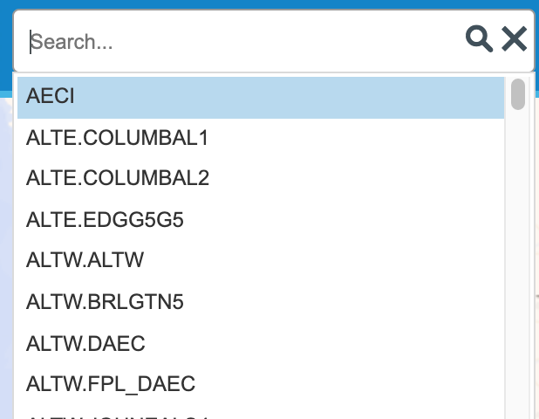
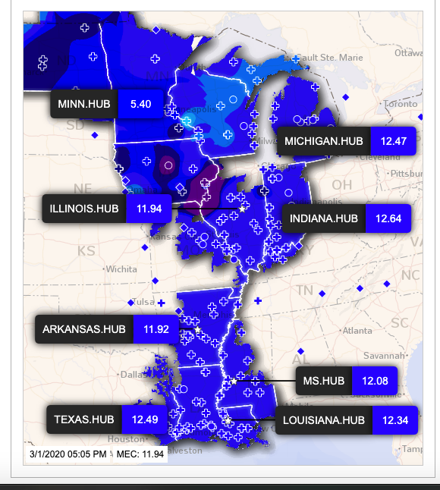
WireFrame
Search

Slide 10
Components
Search Bar
Login component
update/delete
Main Map

Slide 11
Technology Stack
Node.js (Express) server (hosted db) which will send requests on a scheduled basis to the API, and handle refresh requests from the front-end application. https://stackoverflow.com/questions/8011962/schedule-node-js-job-every-five-minutes
React + Mapbox GL: React will be our front-end framework, combined with the Mapbox API to visually display geographic data.

Slide 12
Silver Product
Display Five Minutes of Miso Wholesale Energy product

Slide 13
VMP Features
Log Page with CRUD features
Backend and Front end.
API full capabilities
Search Features

Slide 14
End of Viable product

Slide 15
Start of the Gold Product

Slide 16
Technology Stack
Node.js (Express) server (hosted db) which will send requests on a scheduled basis to the API, and handle refresh requests from the front-end application. https://stackoverflow.com/questions/8011962/schedule-node-js-job-every-five-minutes
React + Mapbox GL: React will be our front-end framework, combined with the Mapbox API to visually display geographic data.

Slide 17
User Stories
As an user I would like to log in with my name and password
As an user I would like to be able to delete/edit and user
As user I would like to search the Miso database by Node
As an user, I would like to see 5-minute price data on a map for every available node in the MISO (Midwestern Independent System Operator) market.
As an user I would like to use the slide bar to display data
As an user I would like to see the Legend

Slide 18
WireFrame
Welcome To The WholeSale Miso Project
Login
Password

Slide 19
WireFrame
Search
LEGEND
PLAYBACK (REWIND, FASTFORWARD)

Slide 20
WIREFRAME DEFINITIONS
SEARCH
Dropdown text-search that will filter through the list of 2,000 nodes in the MISO market.
PLAYBACK
Allows user to see two days of previous data, press play, and see what prices did during that time frame in fast forward.
LEGEND
Will explain what various colors, and objects mean on the map.

Slide 21
Golden Project:
Display Real Time Wholeasle Price Data
From the Midwest Electricity Market (MISO)
By Teresa Fitzgerald

Slide 22
WireFrame
Search
CHART FOR REAL TIME LOAD
LEGEND
PLAYBACK (REWIND, FASTFORWARD)

Slide 23
WIREFRAME DEFINITIONS
SEARCH
Dropdown text-search that will filter through the list of 2,000 nodes in the MISO market.
CHART REAL TIME LOAD
Embedded chart that displays 5-minute real time load.
PLAYBACK
Allows user to see two days of previous data, press play, and see what prices did during that time frame in fast forward.
LEGEND
Will explain what various colors, and objects mean on the map.

Slide 24
Components
Search Bar
Real Time Load Chart
Login component
Main Map
update/delete
Legend
Playback

Slide 25
Summary of Features
1. Live display of 5-minute price information, updated every 5 minutes.
2. The ability to play-back two previous days and see how prices affected different areas.
3. Color coded prices to visualize the difference in regions across the Midwest.
3. Real time load graph. (Load is the demand for electricity at a given moment)
4. If enough time is left: weather overlay - of temperature, wind speeds, etc., that can show the relationship between weather and wholesale electricity price.
The data will be stored in a database (your choice), in order to "replay" a day's events.

Slide 26
Sample API Data
https://www.misoenergy.org/markets-and-operations/RTDataAPIs/
https://api.misoenergy.org/MISORTWDDataBroker/DataBrokerServices.asmx?messageType=getlmpconsolidatedtable&returnType=json
{"LMPData":{"RefId":"01-Mar-2020 - Interval 18:45 EST","FiveMinLMP":{"HourAndMin":"18:45","PricingNode":[{"name":"EES.RVRBEND1","region":"South","LMP":"15.11","MCC":"0.00","MLC":"0.16"},{"name":"EES.PERVL1","region":"South","LMP":"14.64","MCC":"0.00","MLC":"-0.31"},{"name":"SIGE.10ABBGN2","region":"Midwest","LMP":"21.14","MCC":"5.36","MLC":"0.83"},{"name":"MEC.PPWIND","region":"Midwest","LMP":"3.37","MCC":"-8.68","MLC":"-2.90"},{"name":"TVA.WHITEOAK","region":"Midwest","LMP":"15.11","MCC":"0.42","MLC":"-0.26"},{"name":"LAGN.STET10","region":"South","LMP":"14.63","MCC":"0.00","MLC":"-0.32"},{"name":"EAI.AECCHYDRO9","region":"South","LMP":"14.43","MCC":"0.00","MLC":"-0.52"}”

Slide 27
Technology Stack
AWS Lambda: to download data on a scheduled interval from the MISO API.
AWS-managed database: either Postgres, DynamoDB or potentially just S3.
API Gateway: to expose one endpoint (/GET) to the database by which the application can receive data.
Node.js (Express) server (hosted db)?): which will send requests on a scheduled basis to the API, and handle refresh requests from the front-end application.
React + Mapbox GL: React will be our front-end framework, combined with the Mapbox API to visually display geographic data.

Slide 28
User Stories
As an user, I would like to see 5-minute price data on a map for every available node in the MISO (Midwestern Independent System Operator) market.
As a user, I would like this price data to be color-coded, so I can easily see the difference between high prices and low prices on a map.
As a user, I would like to be able to toggle the nodes I would like to see data for.
As a user, I would like to be able to replay 5-minute data over the previous 24 hours.

Slide 29
Conclusion
This project present a graphic picture of real time wholesale electricity prices, specifically in the MISO market (Midwestern Independent System Operator). This project will allow me the opportunity to practice traditional software development along with serverless development.
Some of the patterns I will be utilizing:
ETL (Extraction, Transform Load)
Handling of time-series and geographic data
Charting
Utilizing an open source mapping framework
Serverless infrastructure and development (Lambda, AWS managed database)

